Slide 1
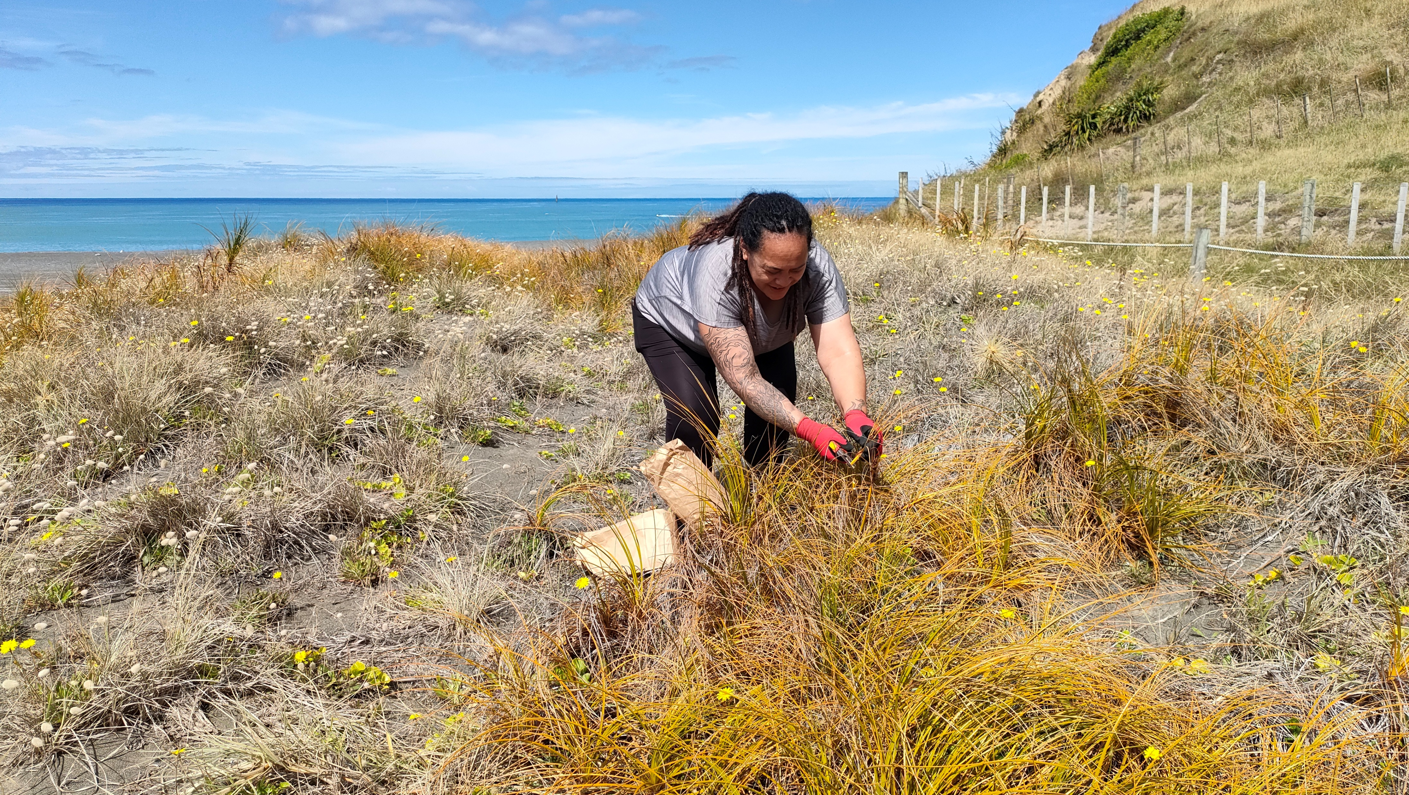
Leonie and I collecting Pīngao seed from Whangaimoana on Palliser Bay in January this year. Our planting location is a few kms along the beach.

Slide 2
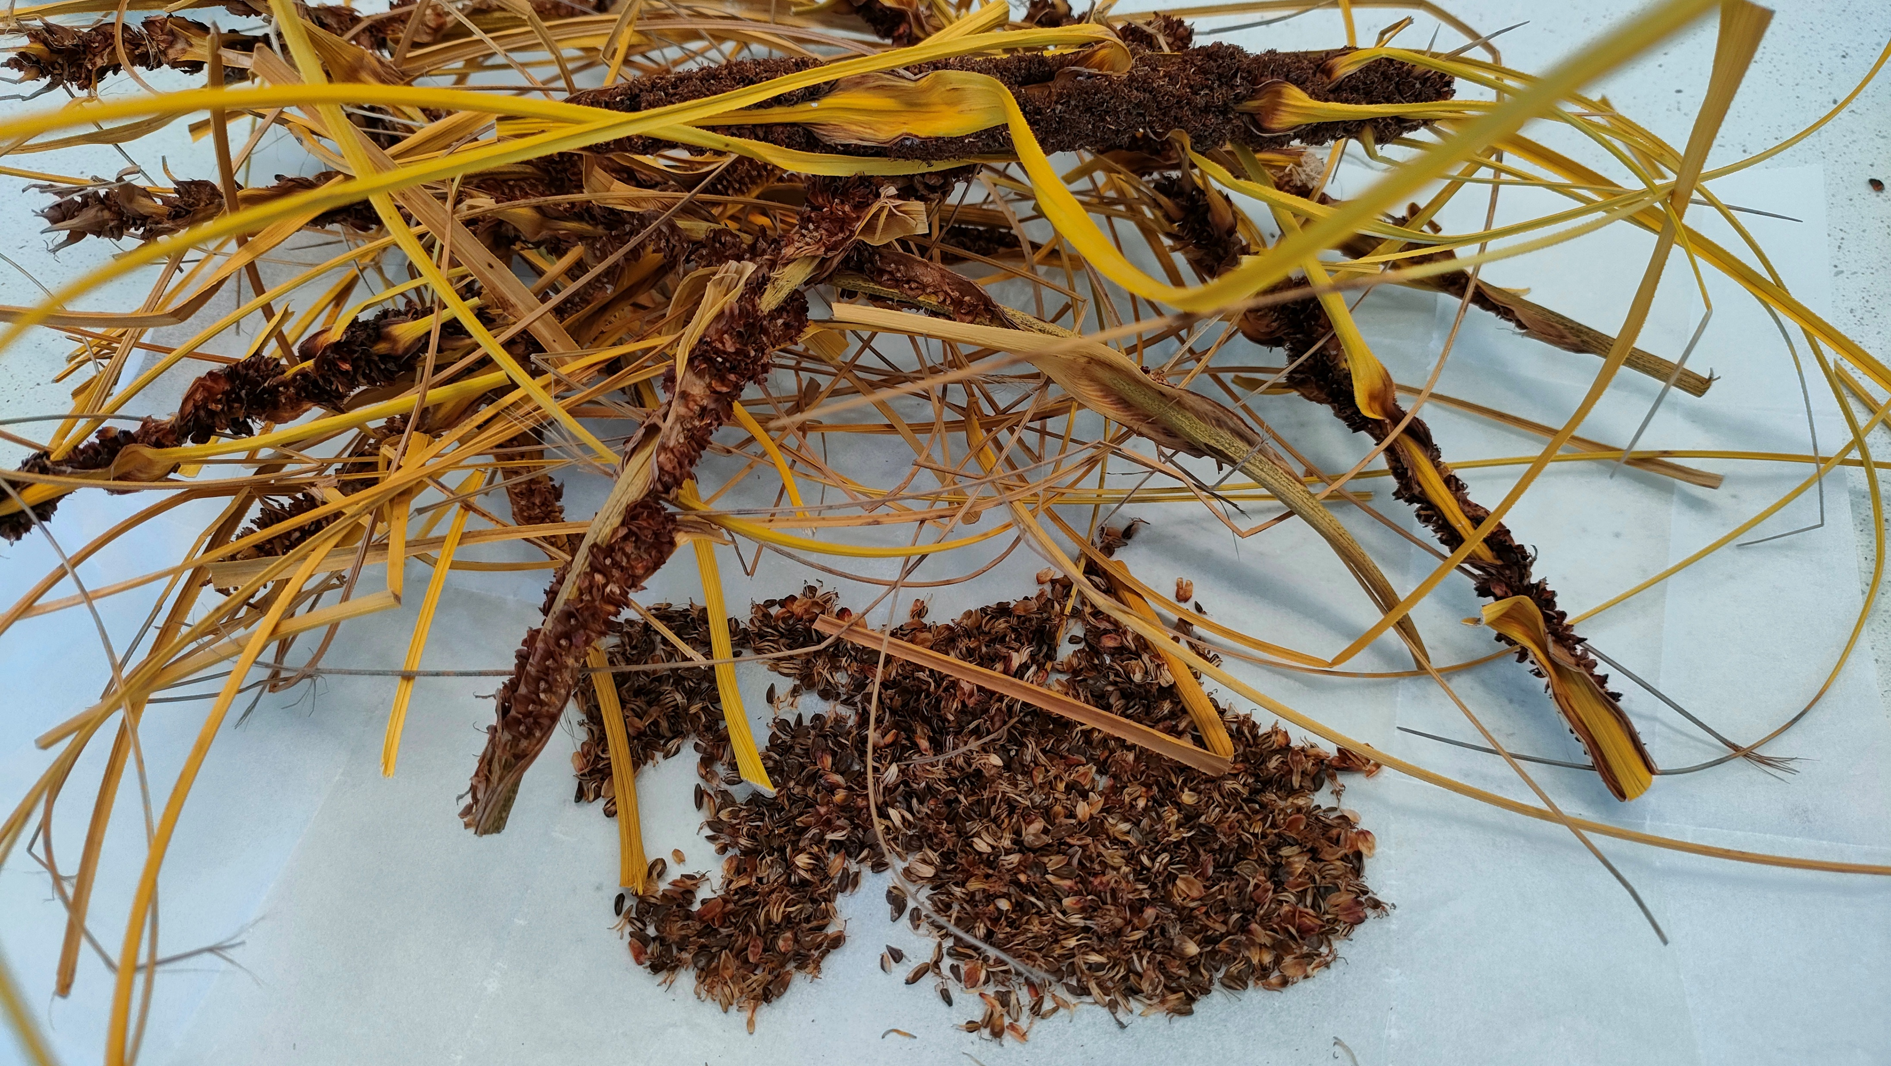

Slide 3
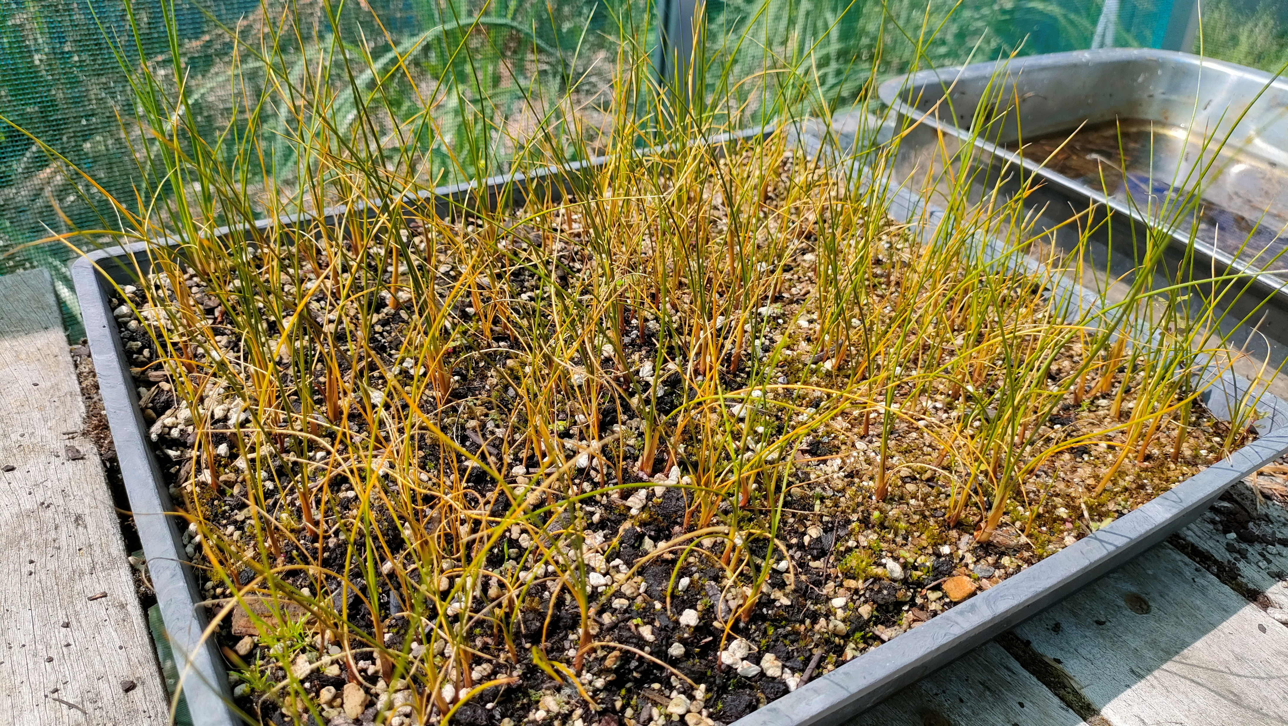

Slide 4
